Slide 1
GLOBAL AZURE 2023 @CHENNAI
Deploy Your First Containerized Application On Azure Using ACI
Deploy Your First Containerized Application On Azure Using ACI

Slide 2


Surendar Singh
SDE Intern @ Cestro Technologies
Pre-final Year @ MIT, Anna University
Btech in Rubber & Plastics Technologies
I want to pursue DevOps as career

Slide 3
Why I started with containerization?
The Need of containerization?

Slide 4
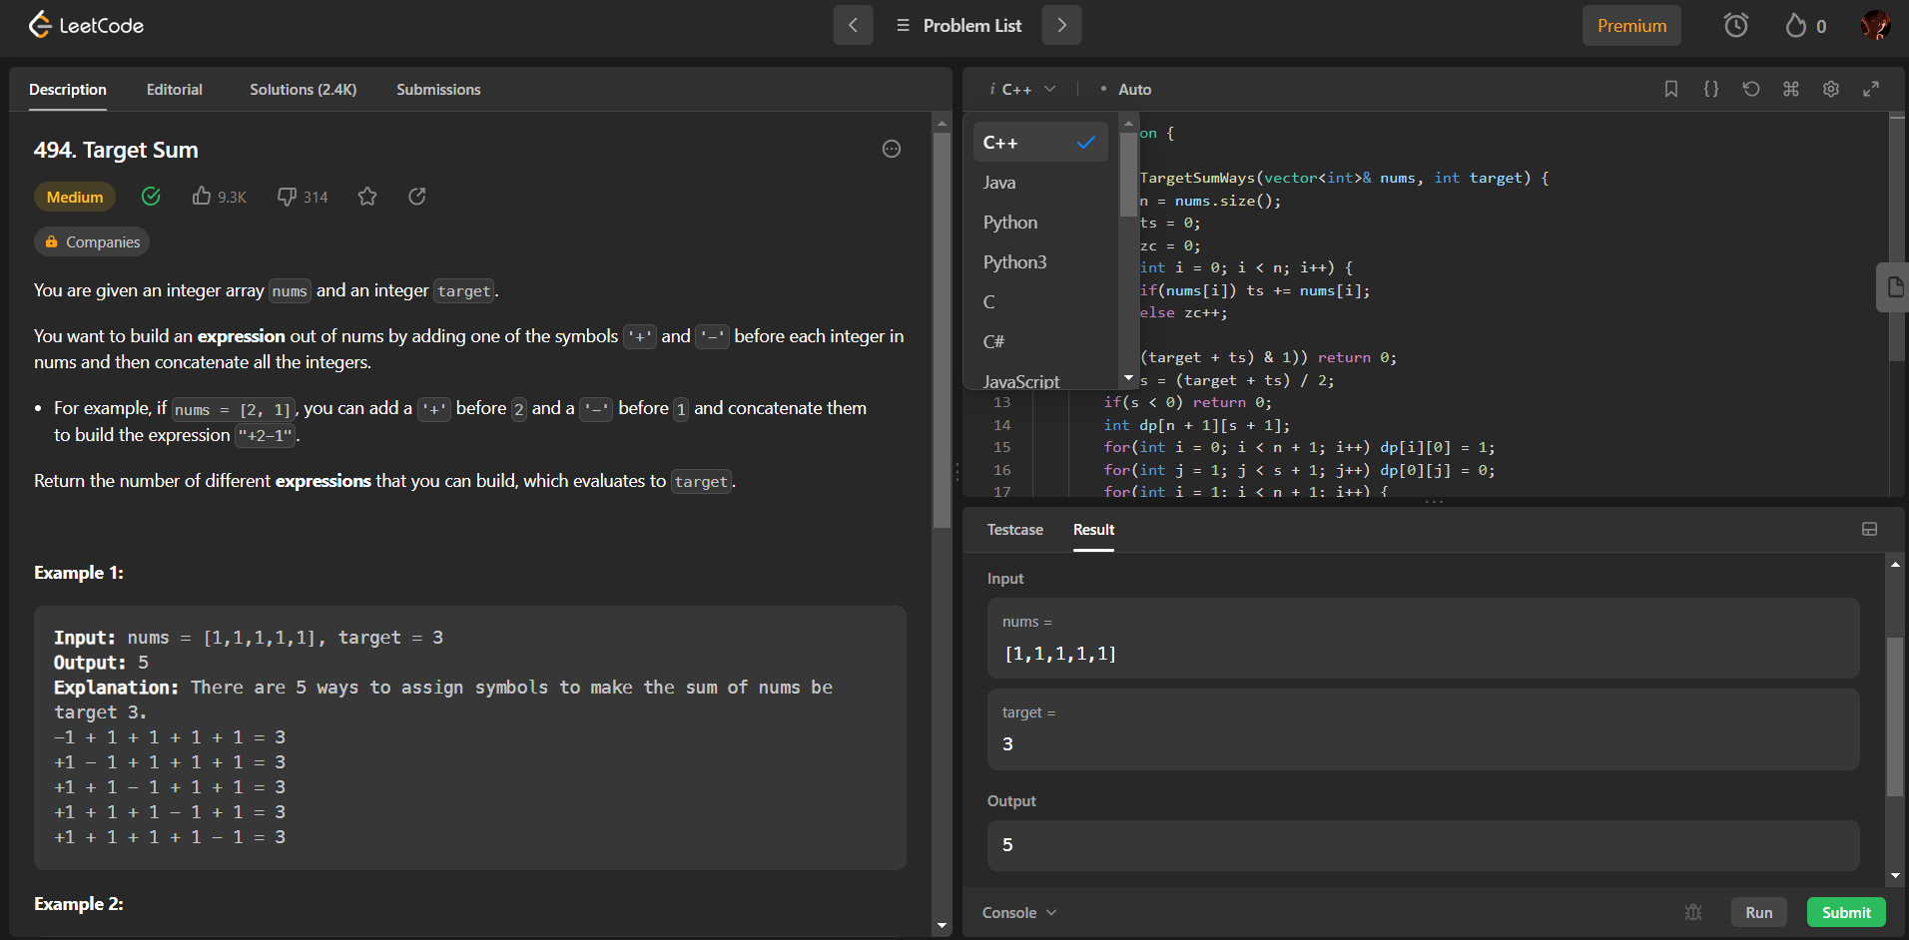
Develop this Tomorrow Surendar!

Slide 5
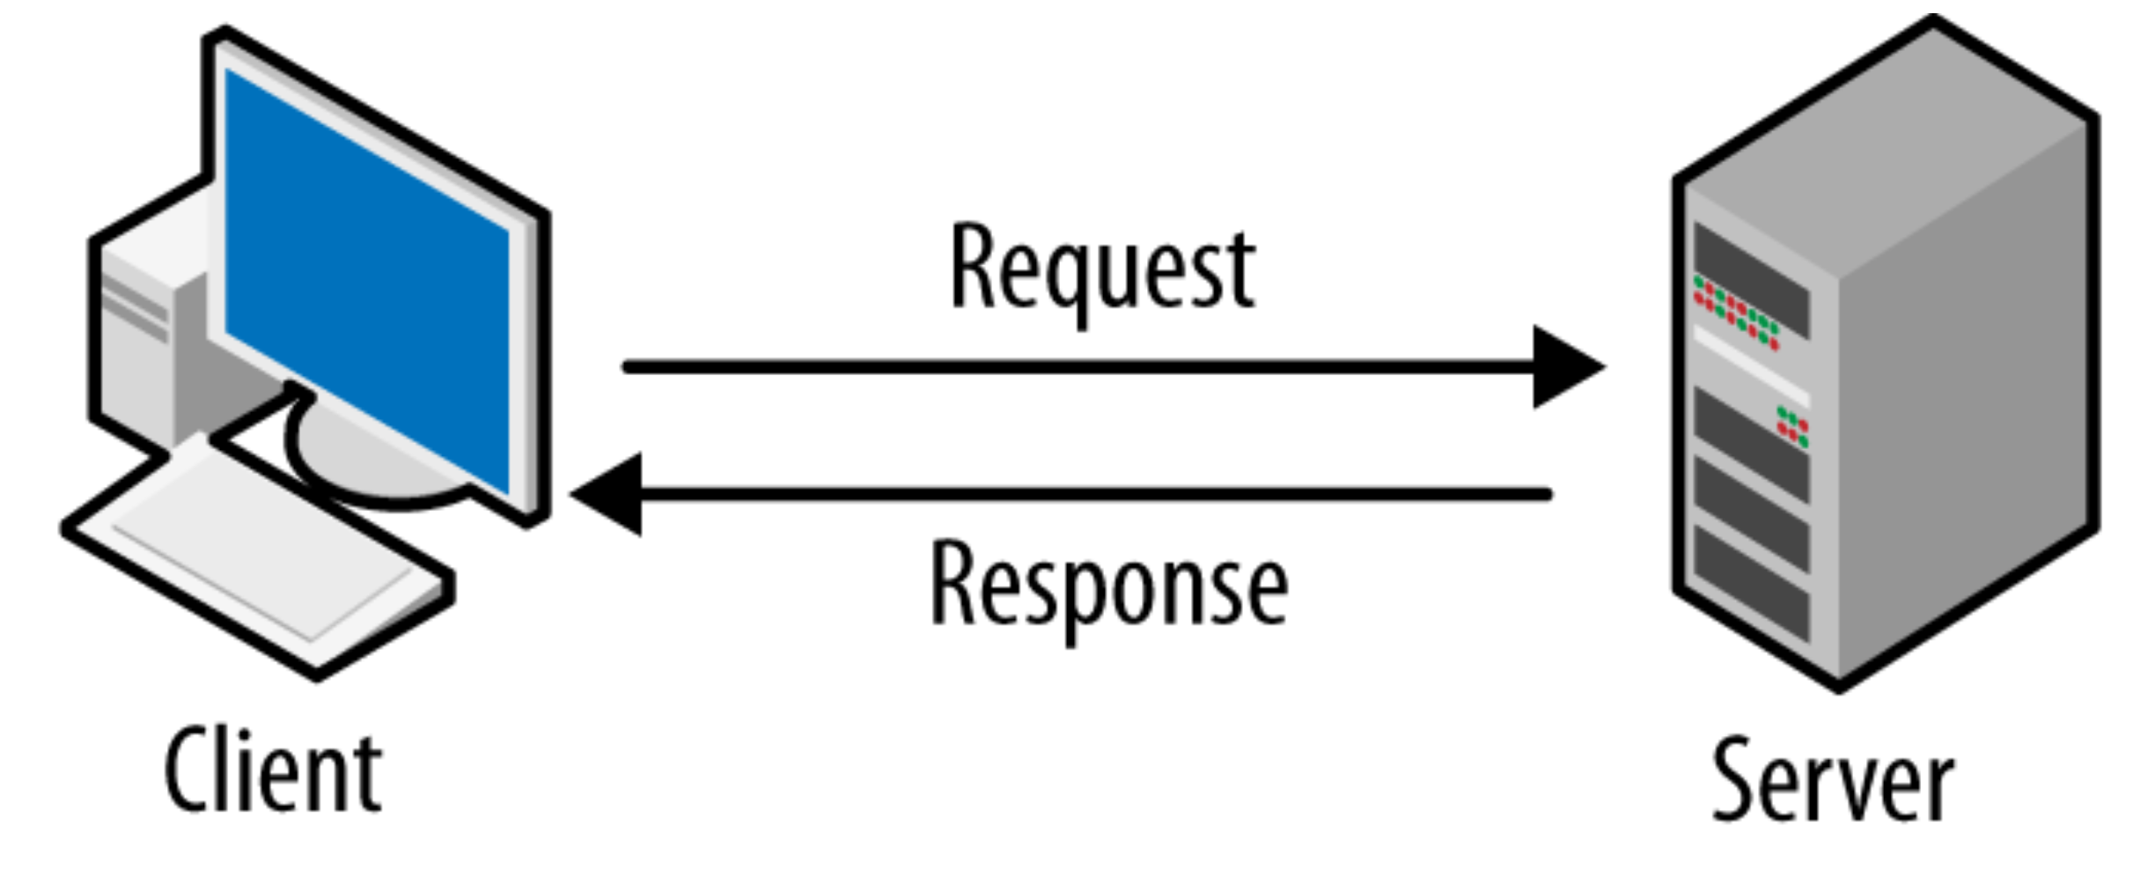
A Simple Architecture:
What If The Code That We Compile Crash Our Server?

Slide 6
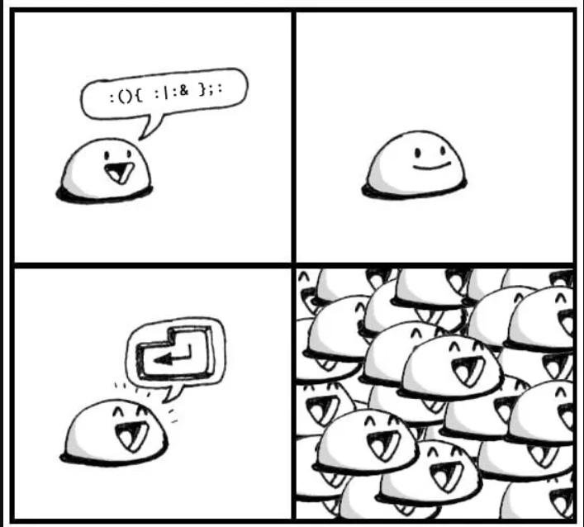
How To Crash Your Server?
“ :(){ :|: & };: ”
This little statement can freeze your system in a second . This is the fork bomb.
Fork Bomb is a denial-of-service attack wherein a process continually replicates itself to deplete available system resources, slowing down or crashing the system due to resource starvation.

Slide 7
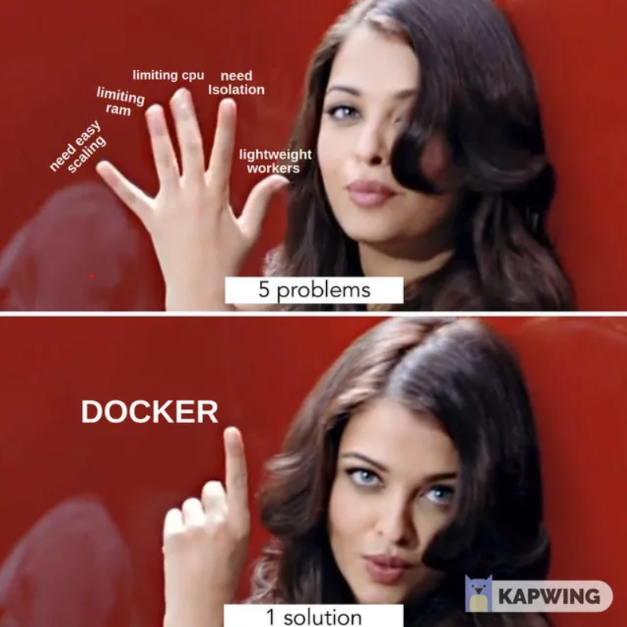
Why? The Need of Containerization?
Running the compiler node inside a container with limited memory and CPU will solve all the problems and also adds an extra layer of security and also spinning up a container is very fast.
If any malicious code was to attempt to destroy the system, its effects would remain inside the container it is working in and we can restart the container very quickly.

Slide 8
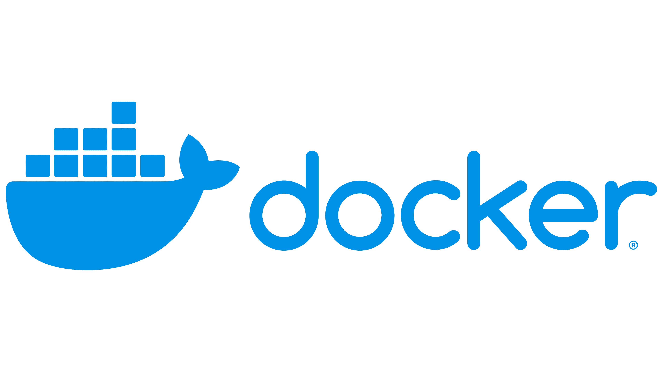
What is

Slide 9
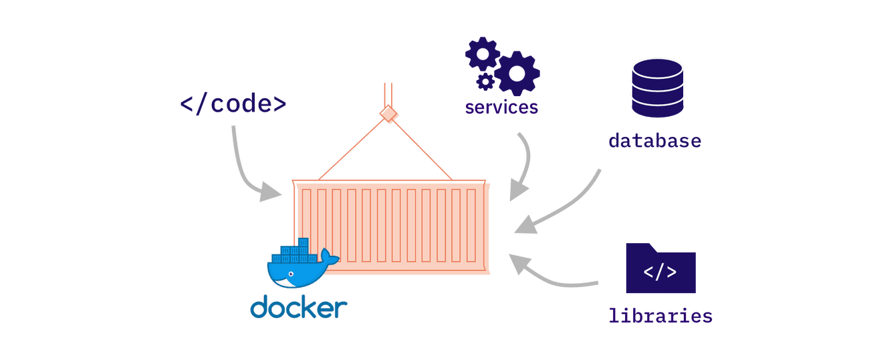
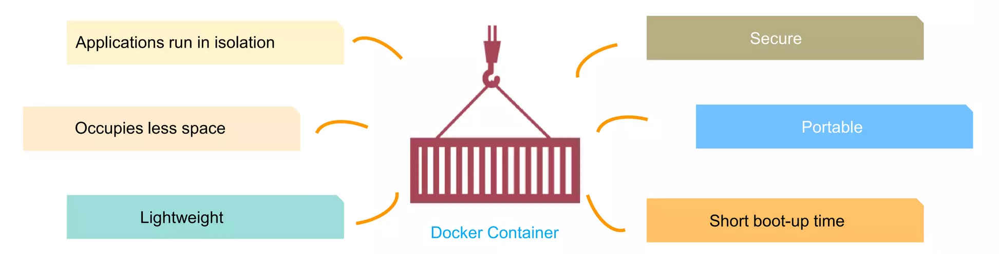
What is Docker:
Docker Container is an executable software package that includes all dependencies (framework, libraries, etc.) required to execute an application.

Slide 10
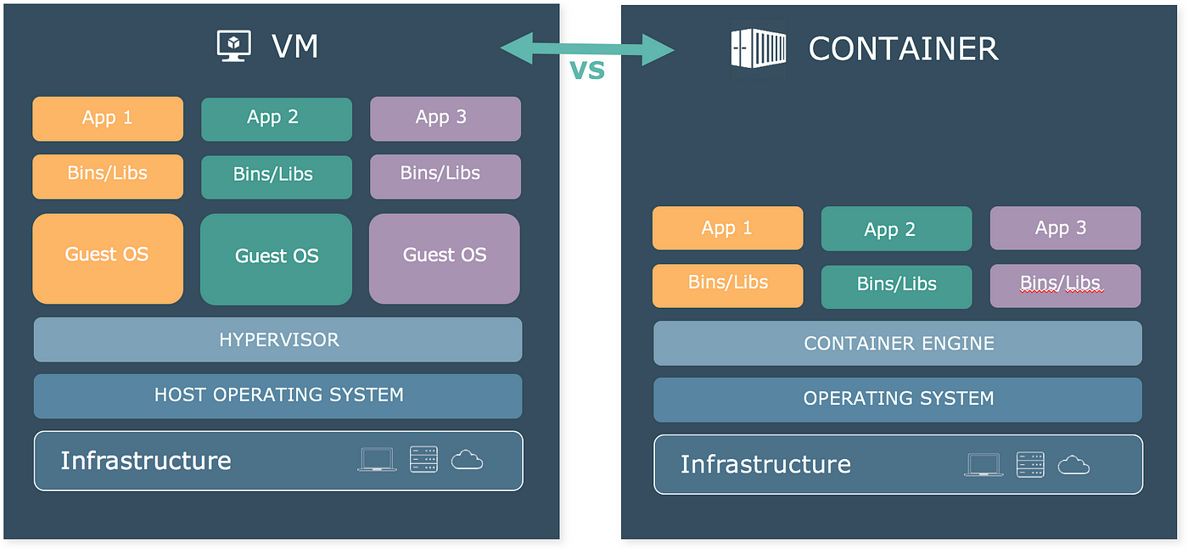
Isn’t Virtual Machine same as Container?

Slide 11
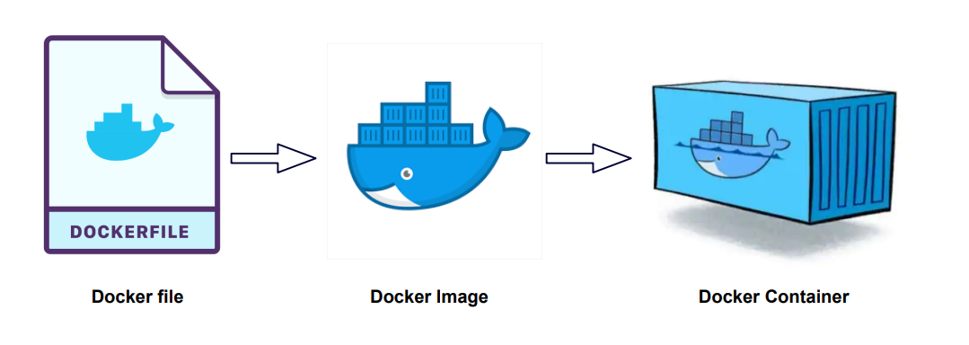
A Container Is Based On An Image:
A Dockerfile is a recipe for creating Docker images
A Docker image gets built by running a Docker command (using Dockerfile)
A Docker container is a running instance of a Docker image

Slide 12
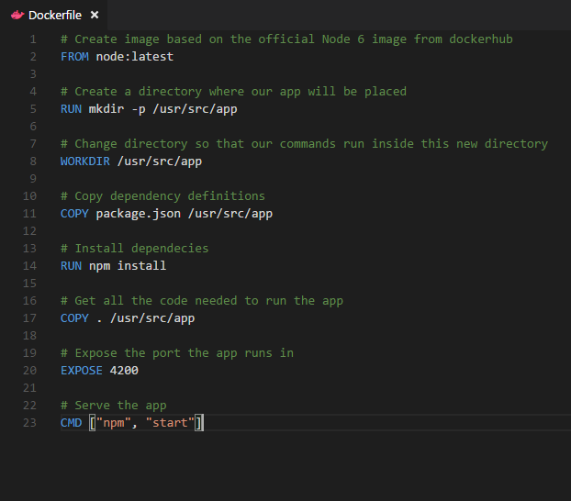
Nodejs App Dockerfile:
Instructions on how to build a Docker image
Looks very similar to “native” commands
Important to optimize your Dockerfile

Slide 13
Each Dockerfile Command Creates a Layer
…
Instructions on how to build a Docker image
Looks very similar to “native” commands
Important to optimize your Dockerfile
EXPOSE
COPY
WORKDIR
RUN
FROM
Kernel

Slide 14
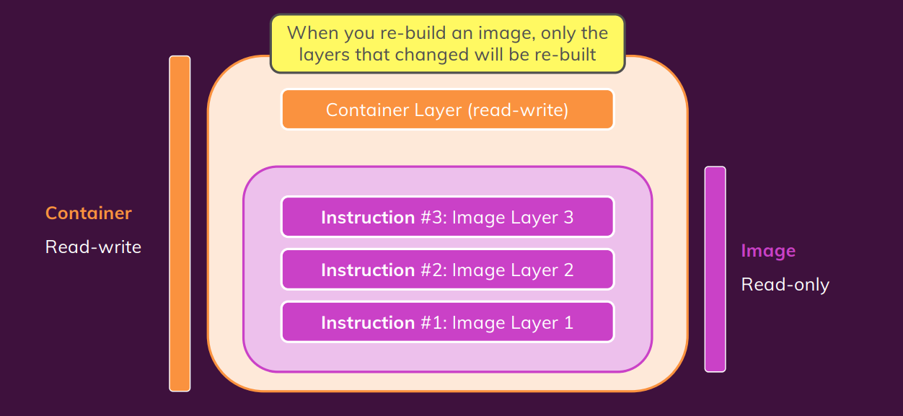
Docker Image Architecture:
A Docker image is a read-only template that contains a set of instructions for creating a container that can run on the Docker platform.

Slide 15
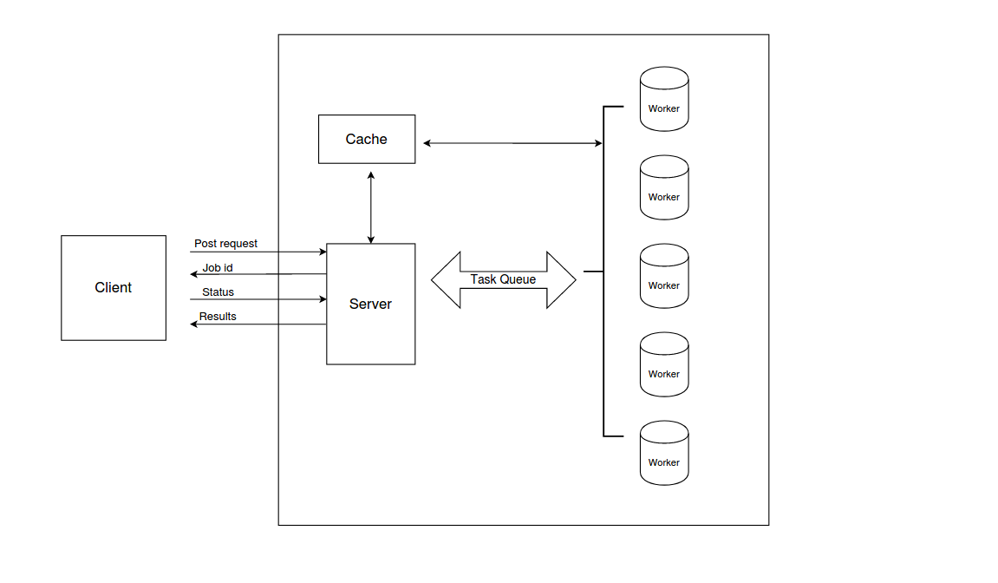
The Good System Design:

Slide 16
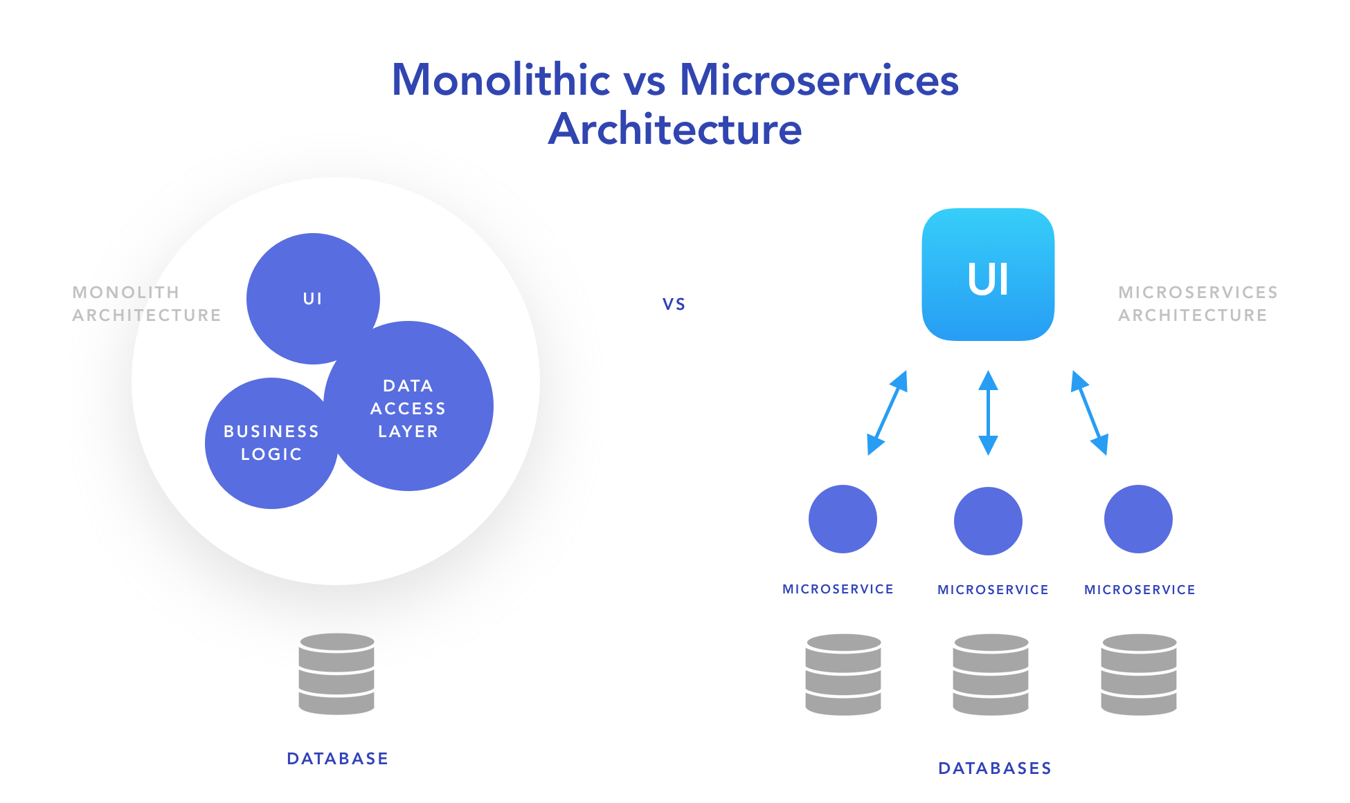
Microservice Application:
Microservices refer to a style of application architecture where a collection of independent services communicate through lightweight APIs.
Famous Companies using Microservices Architecture:
Netflix
Amazon
Uber
Spotify
SoundCloud

Slide 17
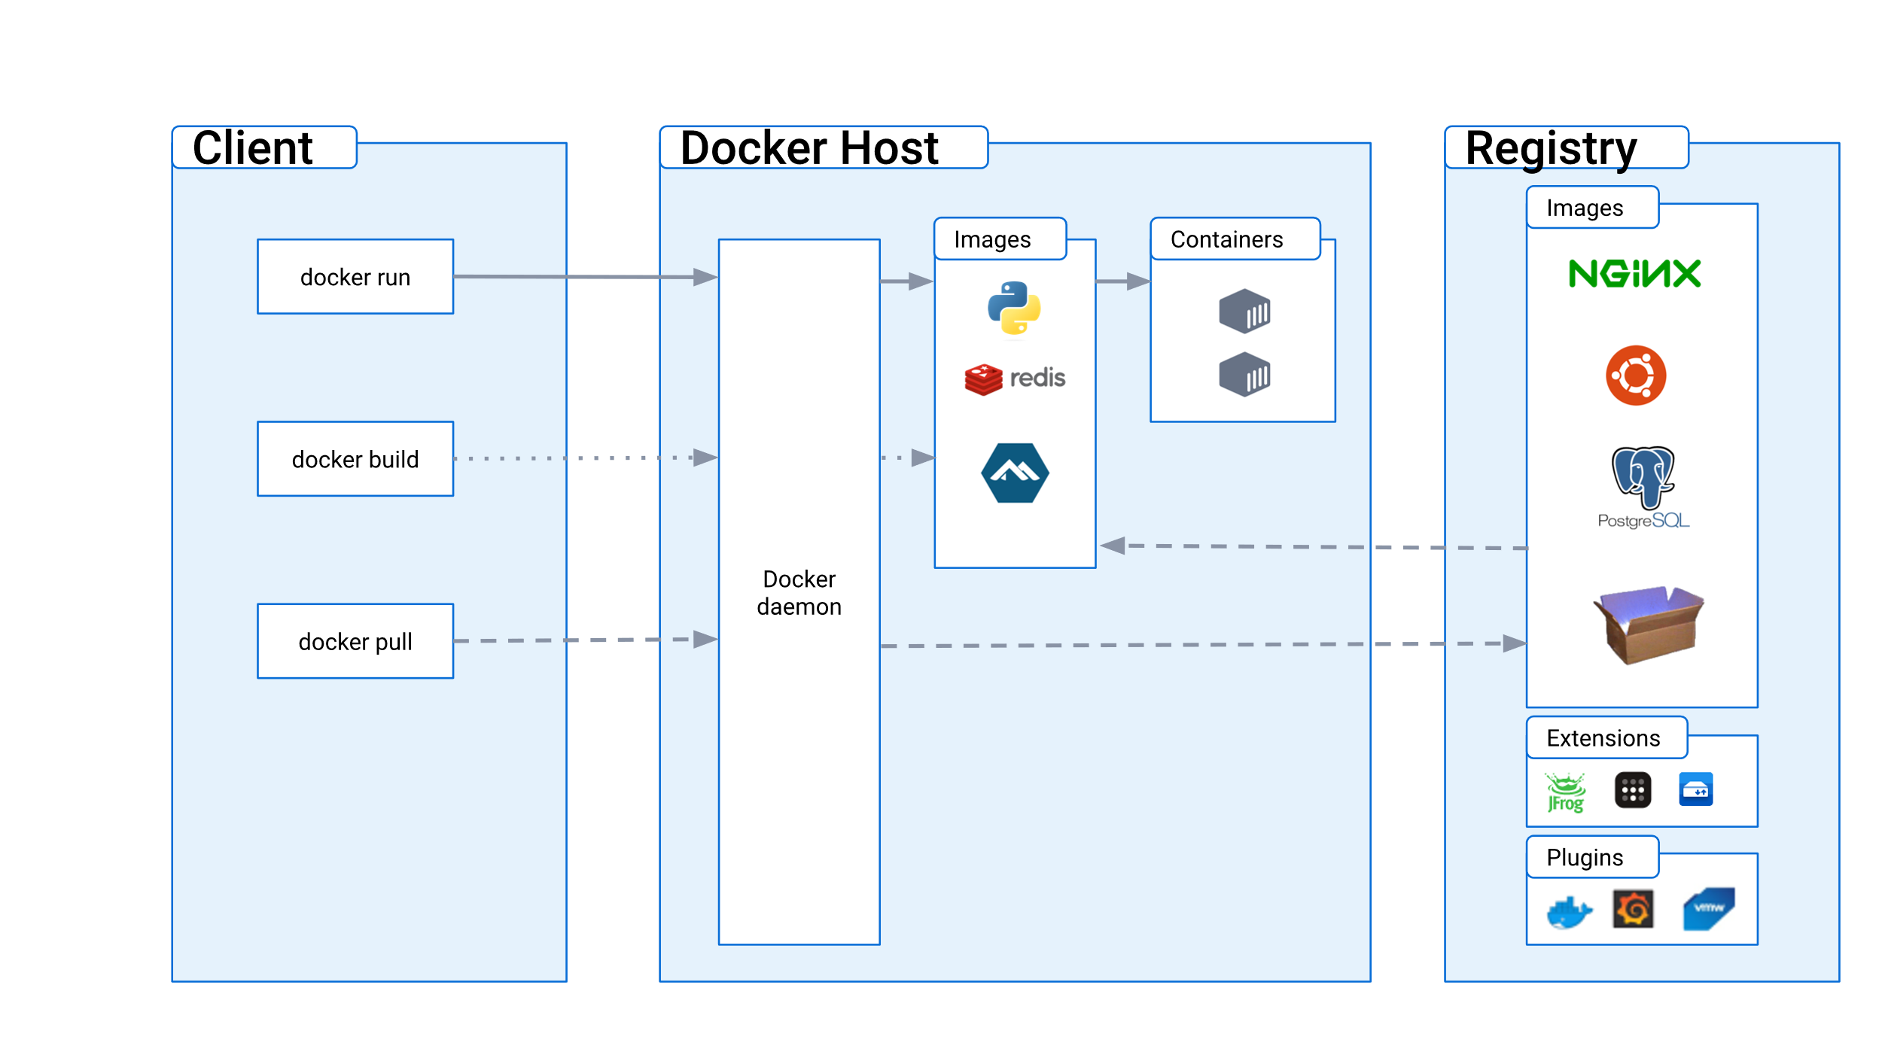
Docker Workflow:

Slide 18
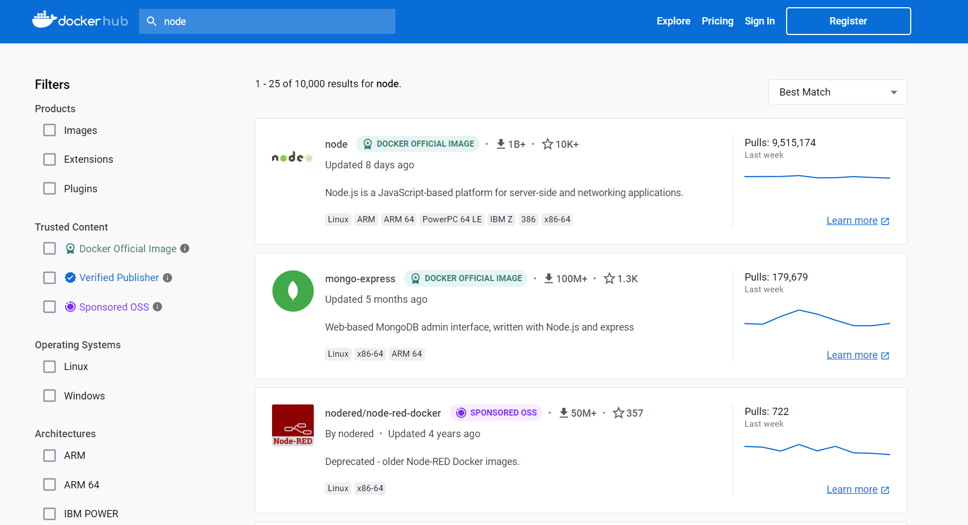
Docker Hub:

Slide 19
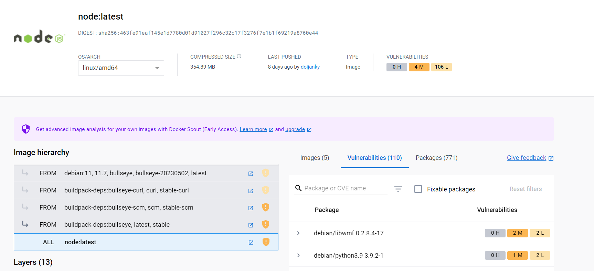
node:latest Image on Docker Hub:

Slide 20
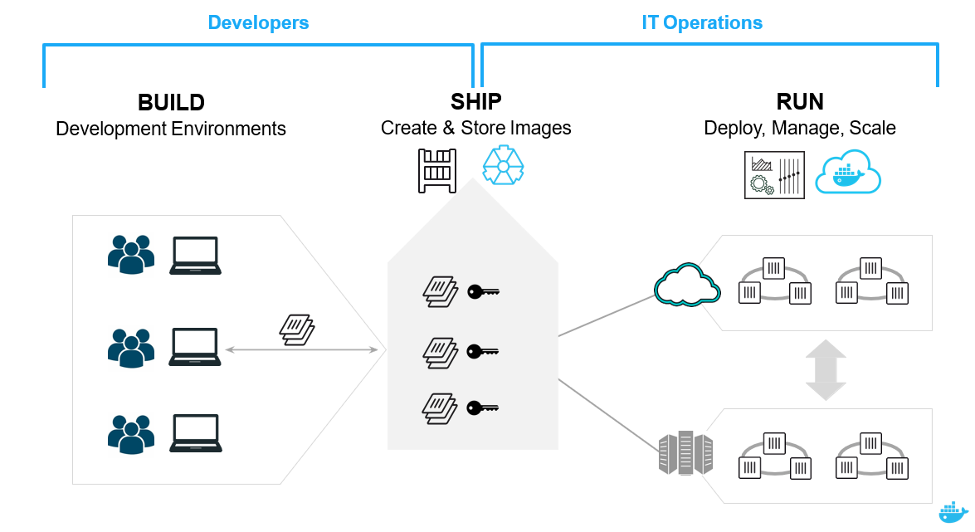
Using Docker: Build, Ship, Run Workflow:

Slide 21
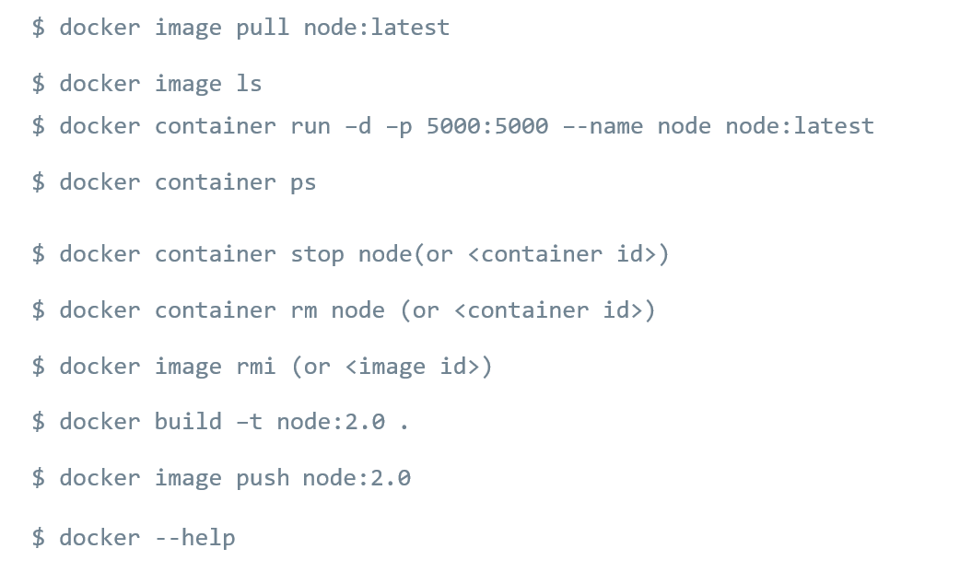
Basic Docker Commands:

Slide 22
Let’s Build a Containerized Application!
Prerequisites:
Docker Desktop (https://www.docker.com/products/docker-desktop)
Required Libraries & Software to compile & run our code (node, npm)
For Windows (at least 4GB ram)
Enable the WSL 2 feature
Enable the Hyper-V and Containers feature

Slide 23
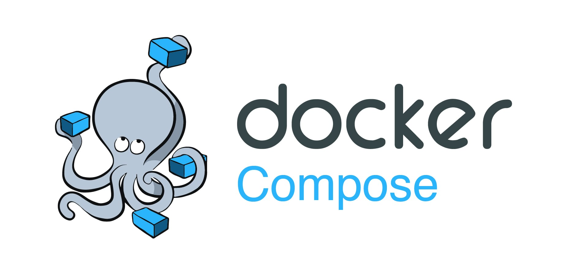

What’s Next?
Docker Compose:
Allows to run multi-container Docker applications reading instructions from a docker-compose.yml file
Kubernetes:
Kubernetes is an open-source container orchestration system for automating software deployment, scaling, and management.

Slide 24
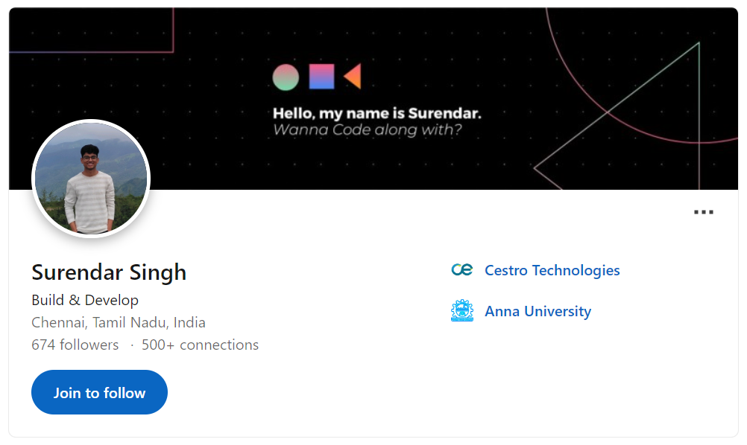
Let’s Connect @ linkedin.com/in/surendarsingh

Slide 25
Q & A ? Feedback!

Slide 26
Thank You!

